Slide 1
Challenge

Slide 2
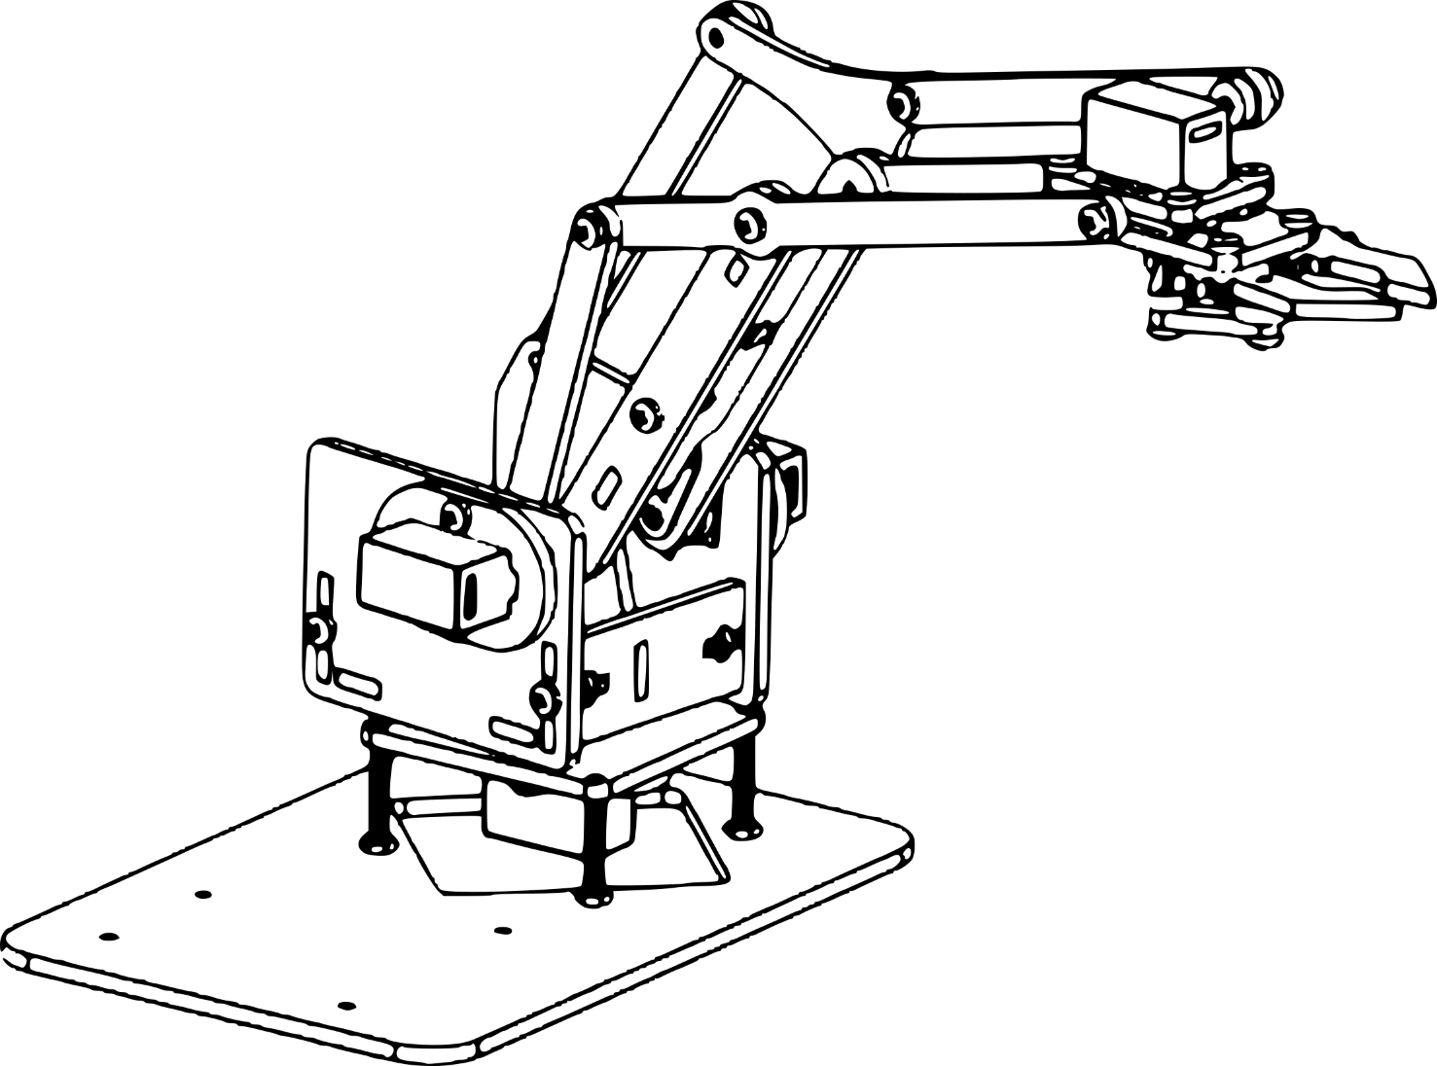
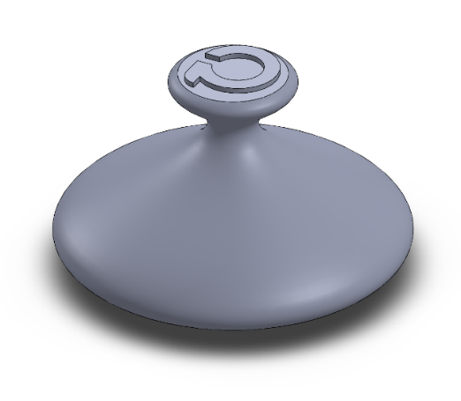
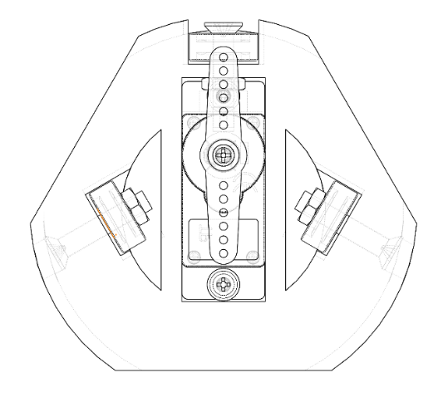
Context
MULTI DOF miniature robotic arm
➔ Arduino control
➔ 4 DOF
MECHANICAL DESIGN
FABRICATION
➔ 3D Printing
ASSEMBLY
DEMONSTRATION

Slide 3


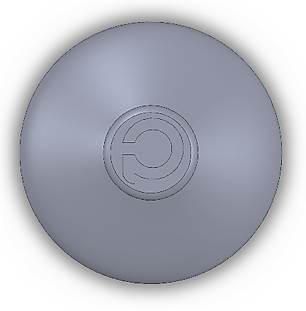
Challenge brief
DEMONSTRATE: a functional 4DOF robotic arm using
➔ ACHIEVING a specific “grab-move-drop” motion
➔ MAXIMIZING the precision and smoothness of the motion
I
II
III

Slide 4
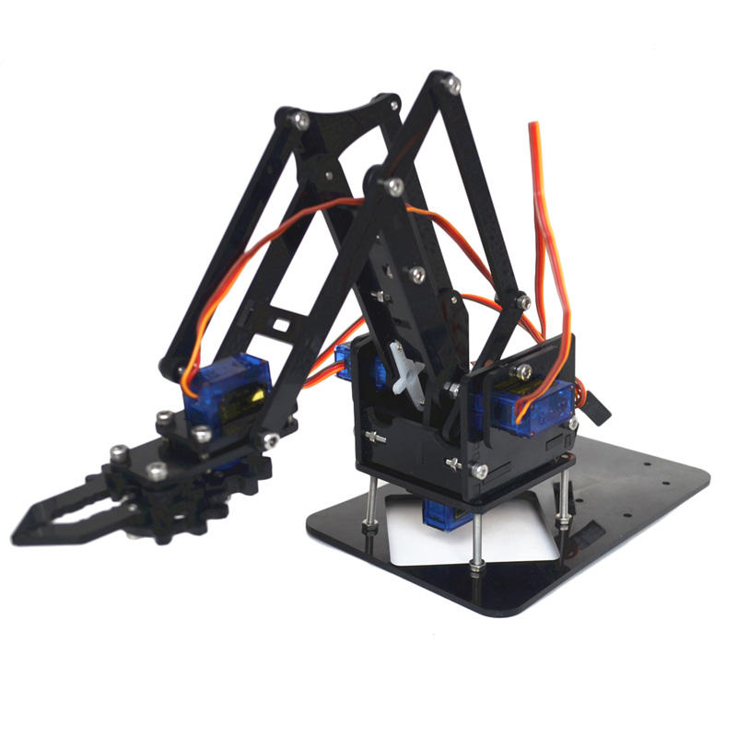
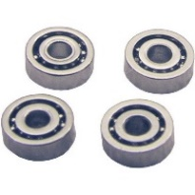

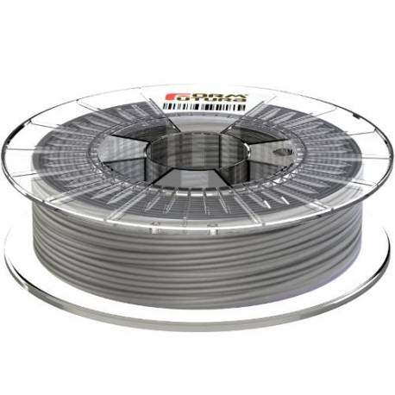
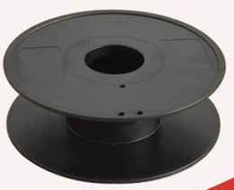
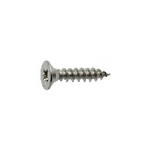
Challenge brief
DESIGN: a constrained 3D printed interface
➔ MINIMIZING the material
➔ MINIMIZING the number of mechanical parts
➔ MAXIMIZING the stiffness and smoothness

Slide 5


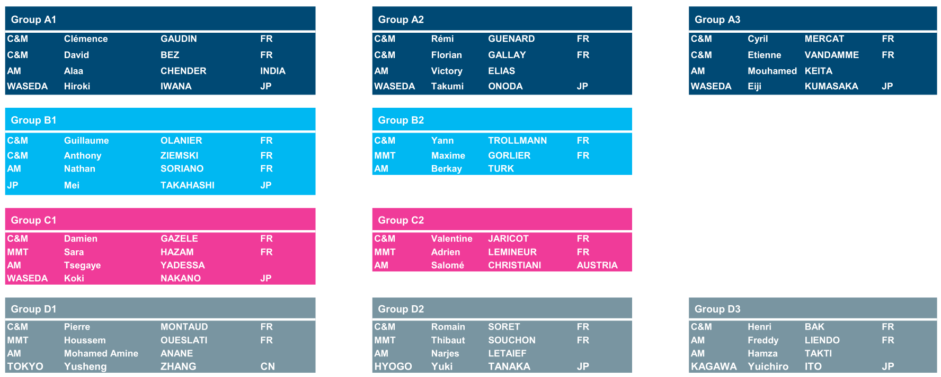
Groups
11 TEAMS of 3 to 4 students
ALLOCATED group letters and students names

Slide 6
Timeline
Friday September, 13
90’ min (all groups)
Tuesday September, 17
90’ min (group B,C,D)
Wednesday September, 18
90’ min (group A)
Final demonstration: Friday September, 20
Professors will discuss and define which is the best accomplishment
(achievement of goals, demonstration, teamwork)

